Slide 1

Select Topics in Python
Introduction to the Course
Notes:
‹#›

Slide 2




Objectives
Lists, Tuples, Dictionaries, Sets
File Reading and Writing
Data Analysis
Demo
Introduction to Lists.
Introduction to Tuples.
Introduction to dictionaries.
Introduction to sets.
Introduction to Reading from a File.
Introduction to Writing to a File.
.
Introduction to Pandas Library.
Introduction to Matplotlib.
Live coding examples for each area.
Notes:
‹#›

Slide 3
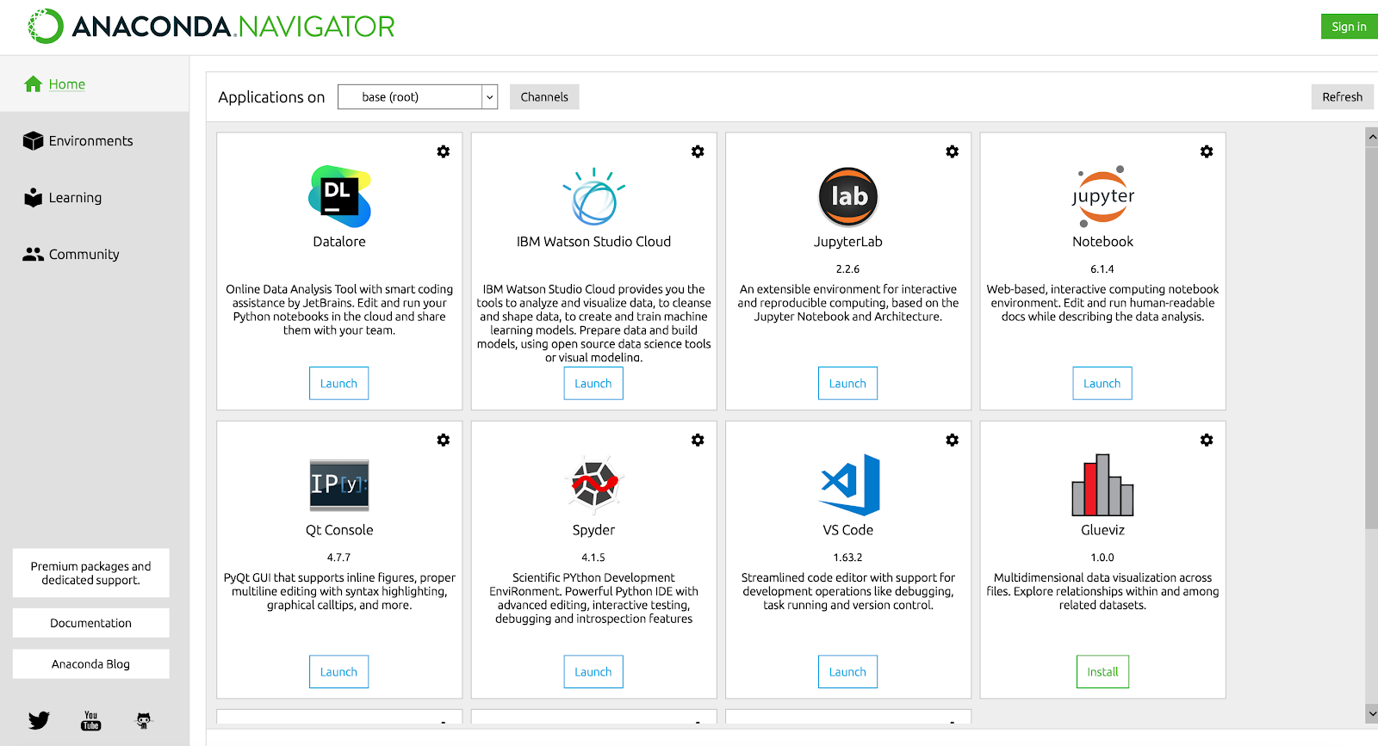
Needed for the Course
Needed for the course:
Python IDE.
CoLab.
Anaconda Navigator
Visual Studio Code
IntelliJ – Pycharm
Jupyter NoteBook
Spider
Anaconda Navigator

